Slide 1
Cornerstone City Church Peninsula Plus Community Hoo Are Ya
13th April 2025

Slide 2


Slide 3
Glorious Day
CCLI Song # 7081388
Jason Ingram | Jonathan Smith | Kristian Stanfill | Sean Curran
© 2017 KPS 1.0 (Admin. by Capitol CMG Publishing)
sixsteps Music (Admin. by Capitol CMG Publishing)
sixsteps Songs (Admin. by Capitol CMG Publishing)
Sounds Of Jericho (Admin. by Capitol CMG Publishing)
Worship Together Music (Admin. by Capitol CMG Publishing)
worshiptogether.com songs (Admin. by Capitol CMG Publishing)
Fellow Ships Music (Admin. by Essential Music Publishing LLC)
Hickory Bill Doc (Admin. by Essential Music Publishing LLC)
So Essential Tunes (Admin. by Essential Music Publishing LLC)
For use solely with the SongSelect® Terms of Use. All rights reserved. www.ccli.com
CCLI Licence No. 33265

Slide 4
1/6
I was buried beneath my shame
Who could carry that kind of weight
It was my tomb 'til I met You

Slide 5
2/6
I was breathing but not alive
All my failures I tried to hide
It was my tomb 'til I met You

Slide 6
3/6
('Cause when) You called my name (and)
I ran out of that grave
Out of the darkness into Your glorious day
You called my name (and) I ran out of that grave
Out of the darkness into Your glorious day

Slide 7
4/6
Now Your mercy has saved my soul
Now Your freedom is all that I know
The old made new Jesus when I met You

Slide 8
5/6
I needed rescue my sin was heavy
But chains break at the weight of Your glory
I needed shelter I was an orphan
Now You call me a citizen of Heaven
When I was broken You were my healing
Now Your love is the air that I'm breathing
I have a future my eyes are open

Slide 9
6/6
('Cause when) You called my name (and)
I ran out of that grave
Out of the darkness into Your glorious day
You called my name (and)
I ran out of that grave
Out of the darkness into Your glorious day

Slide 10
Open The Eyes of My Heart
CCLI Song # 2298355
Paul Baloche
© 1997 Integrity's Hosanna! Music (Admin. by Integrity Music Ltd)
For use solely with the SongSelect® Terms of Use. All rights reserved. www.ccli.com
CCLI Licence No. 33265

Slide 11
1/3
Open the eyes of my heart Lord
Open the eyes of my heart
I want to see You
I want to see You

Slide 12
2/3
To see You high and lifted up
Shining in the light of Your glory
Pour out Your power and love
As we sing holy holy holy

Slide 13
3/3
Holy holy holy
Holy holy holy
Holy holy holy
I want to see You

Slide 15
Firm Foundation (He Won't)
CCLI Song # 7188203
Austin Davis | Chandler Moore | Cody Carnes
© 2021 For Humans Publishing (Admin by Essential Music Publishing)
Maverick City Publishing (Admin by Essential Music Publishing)
Capitol CMG Paragon (Admin. by Capitol CMG Publishing)
TBCO Publishing (Admin. by Capitol CMG Publishing)
Writer's Roof Publishing (Admin. by Capitol CMG Publishing)
A.L.K.D. Music (Admin. by Watershed Music Group (Admin. by Capitol CMG Publishing))
For use solely with the SongSelect® Terms of Use. All rights reserved. www.ccli.com
CCLI Licence No. 33265

Slide 16
1/7
Christ is my firm foundation
The rock on which I stand
When everything around me is shaken
I've never been more glad
That I put my faith in Jesus
'Cause He's never let me down
He's faithful through generations
So why would He fail now

Slide 17
2/7
He won’t
He won't

Slide 18
3/7
I've still got joy in chaos
I've got peace that makes no sense
So I won't be going under
I'm not held by my own strength
'Cause I've built my life on Jesus
He's never let me down
He's faithful in every season
So why would He fail now

Slide 19
4/7
He won’t He won't
He won't fail
He won't fail

Slide 20
5/7
Rain came and wind blew
My house was built on You
I'm safe with You
I'm going to make it through

Slide 21
6/7
I'm going to make it through
‘Cause I’m standing strong on You
I’m going to make it through
‘Cause my house is built on You

Slide 22
7/7
Christ is my firm foundation
The rock on which I stand
When everything around me is shaken
I've never been more glad
That I put my faith in Jesus
'Cause He's never let me down
He's faithful through generations
So why would He fail now

Slide 24
Living Hope CCLI Song # 7106807
Brian Johnson | Phil Wickham
© 2017 Phil Wickham Music; Simply Global Songs; Sing My Songs; Bethel Music Publishing
For use solely with the SongSelect® Terms of Use. All rights reserved. www.ccli.com
CCLI Licence No. 33265

Slide 25
1/6
How great the chasm that lay between us
How high the mountain I could not climb
In desperation I turned to heaven
And spoke Your name into the night
Then through the darkness Your loving-kindness
Tore through the shadows of my soul
The work is finished the end is written
Jesus Christ my living hope

Slide 26
2/6
Who could imagine so great a mercy
What heart could fathom such boundless grace
The God of ages stepped down from glory
To wear my sin and bear my shame
The cross has spoken I am forgiven
The King of kings calls me His own
Beautiful Savior I’m Yours forever
Jesus Christ my living hope

Slide 27
3/6
Hallelujah praise the One who set me free
Hallelujah death has lost its grip on me
You have broken every chain
There’s salvation in Your name
Jesus Christ my living hope

Slide 28
4/6
Then came the morning that sealed the promise
Your buried body began to breathe
Out of the silence the Roaring Lion
Declared the grave has no claim on me
(REPEAT)
Jesus Yours is the victory whoa

Slide 29
5/6
Hallelujah praise the One who set me free
Hallelujah death has lost its grip on me
You have broken every chain
There’s salvation in Your name
Jesus Christ my living hope

Slide 30
6/6
Jesus Christ my living hope
Oh God You are my living hope

Slide 32
How Great Thou Art
CCLI Song # 14181
Stuart Wesley Keene Hine
© Copyright 1949 and 1953 Stuart Hine Trust CIO Stuart K. Hine Trust
For use solely with the SongSelect® Terms of Use. All rights reserved. www.ccli.com
CCLI Licence No. 33265

Slide 33
1/5
Verse 1
O Lord my God when I in awesome wonder
Consider all the works Thy hand hath made
I see the stars I hear the mighty thunder
Thy pow'r throughout the universe displayed

Slide 34
2/5
Chorus
Then sings my soul my Saviour God to Thee
How great Thou art how great Thou art
Then sings my soul my Saviour God to Thee
How great Thou art how great Thou art

Slide 35
3/5
Verse 2
When through the woods and forest glades I wander
And hear the birds sing sweetly in the trees
When I look down from lofty mountain grandeur
And hear the brook and feel the gentle breeze

Slide 36
4/5
Verse 3
And when I think that God His Son not sparing
Sent Him to die I scarce can take it in
That on the Cross my burden gladly bearing
He bled and died to take away my sin

Slide 37
5/5
Verse 4
When Christ shall come with shout of acclamation
And take me home what joy shall fill my heart
Then shall I bow in humble adoration
And there proclaim my God how great Thou art

Slide 38


Slide 39


Slide 40
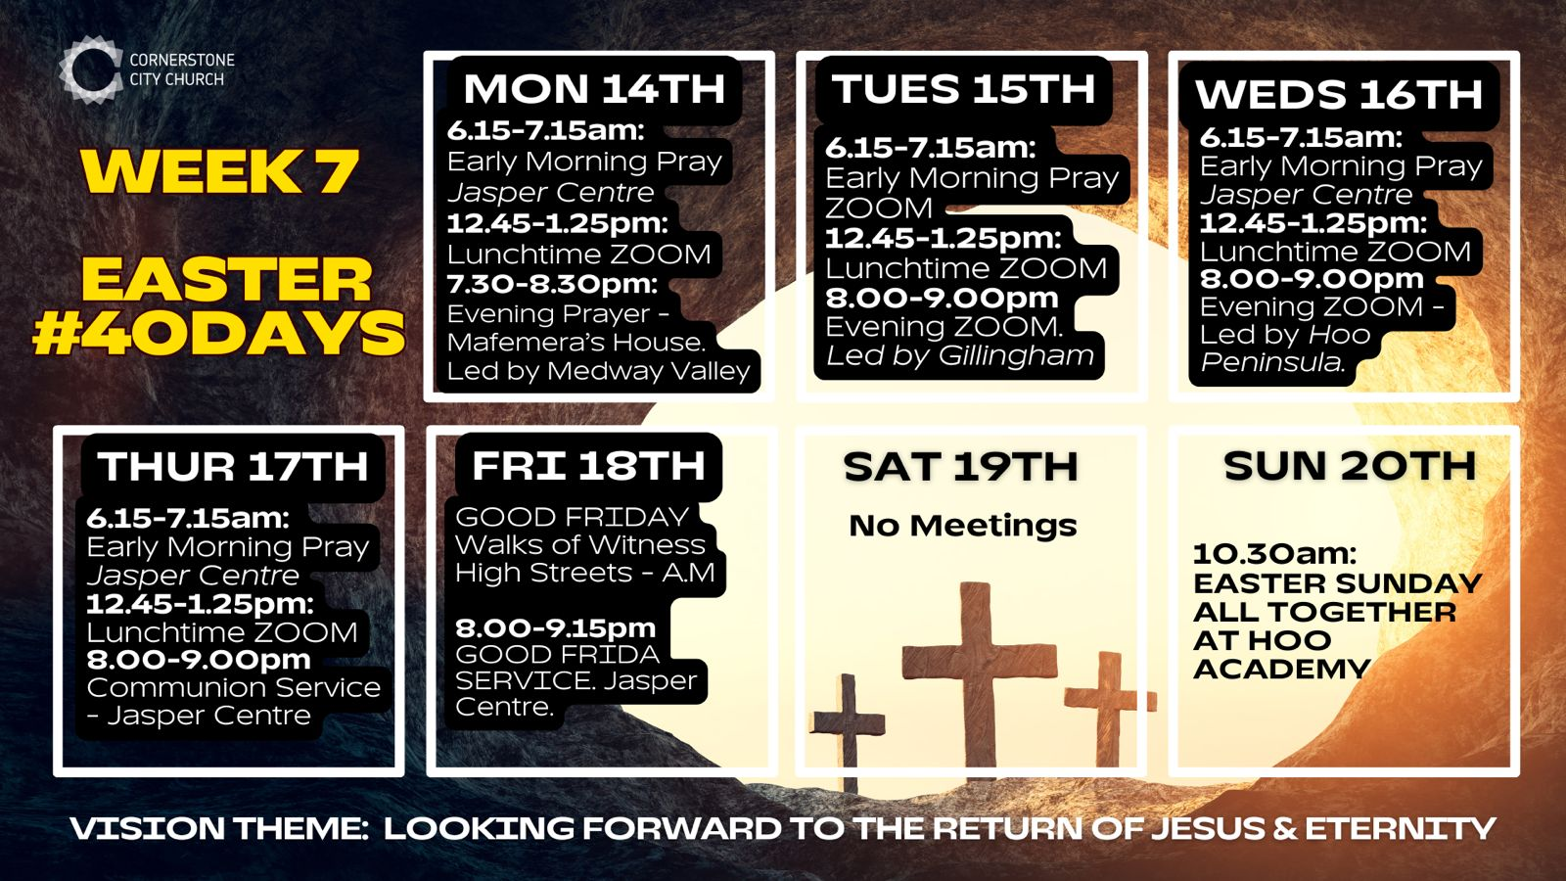
https://files.logoscdn.com/v1/files/83654762/assets/16863512/content.png?signature=ME1eOBr43tL81FDNTDJrm0TIp3M

Slide 41


Slide 42


Slide 43
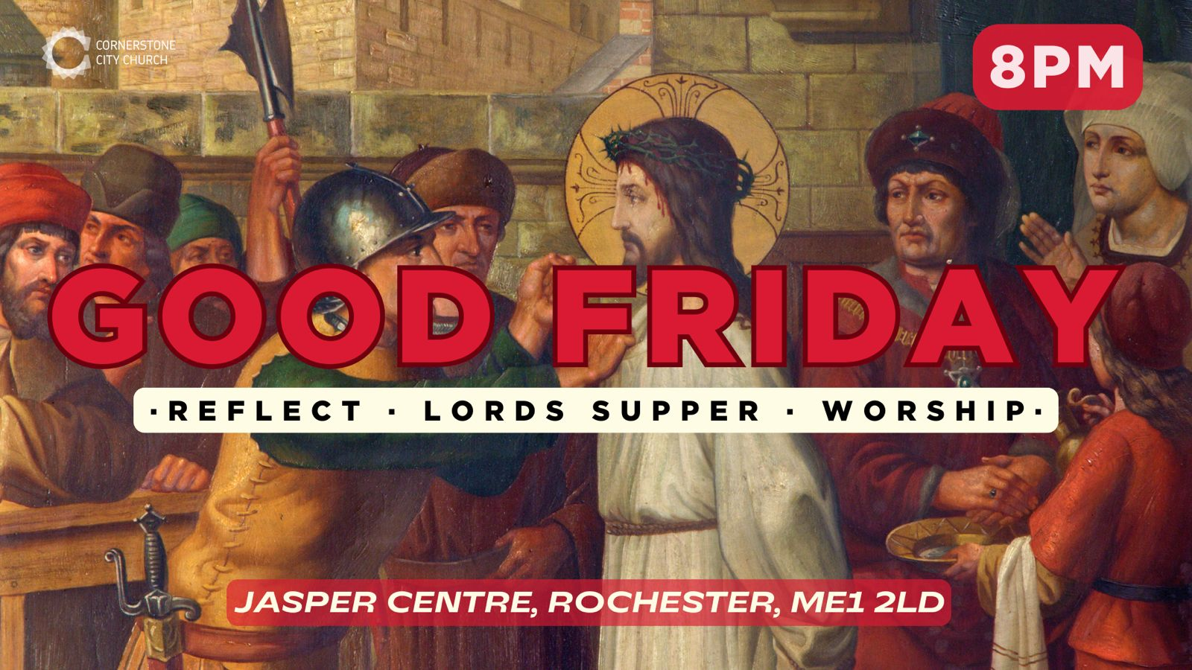

Slide 44


Slide 45


Slide 46


Slide 47
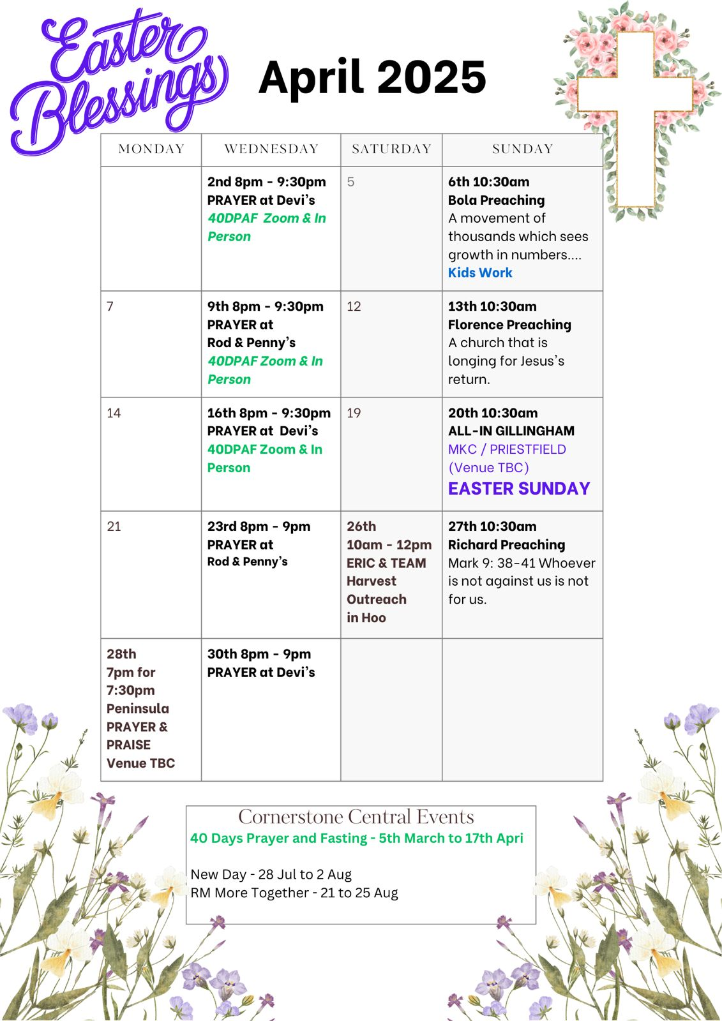

Slide 48

Grow Group 1
On YOUR MARK!

Slide 49
Leaders
Leaderss
Phil & Kim
Maria (Mia) Warren
Matthew Harrison
Richard & Elisha Acheampong
Phil & Kim
Maria (Mia) Warren
Matthew Harrison
Richard & Elisa Acheampong

Slide 50
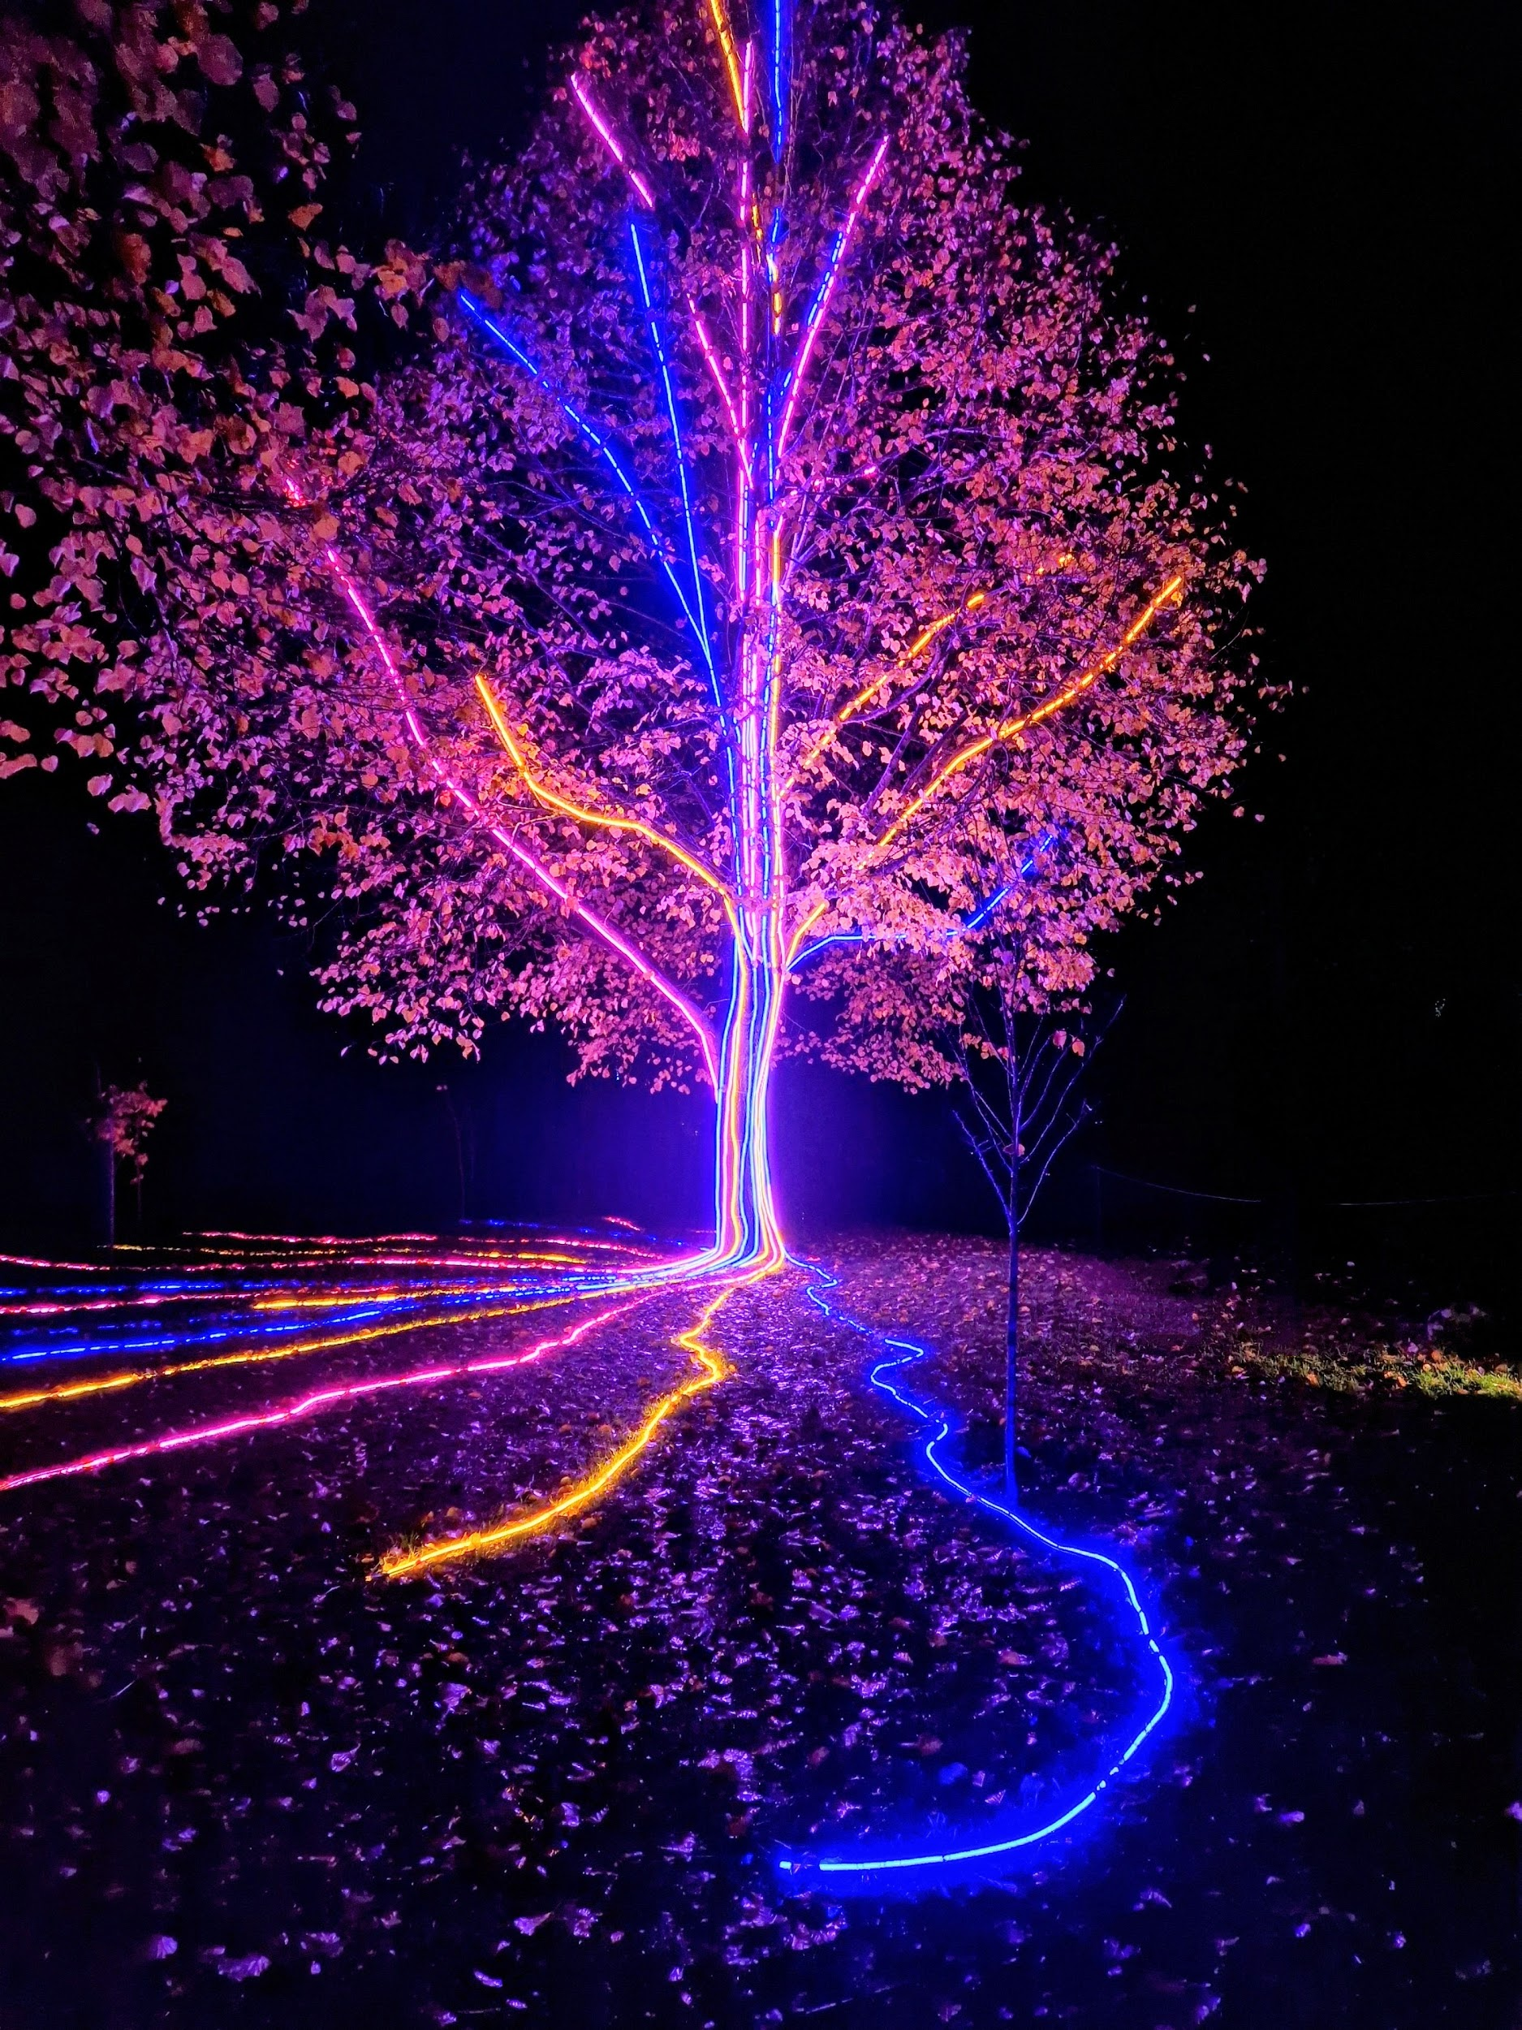
Storm Walker
Storm Walker
Symbolising, trust in Jesus Christ through life's storms.
Mark 4:35-41

Slide 51



Group Leaders
Micheal and Mwamba
Wilfred and Parveen
Hannah

Slide 52


Slide 53


Slide 54
2 Corinthians 14 May the grace of the Lord Jesus Christ, and the love of God, and the fellowship of the Holy Spirit be with you all
Surely goodness and mercy shall follow me all the days of my life, and I shall dwell in the house of the Lord forever.

